Slide 1


Green Pace
Security Policy Presentation
Developer: Nate Bennett

Slide 2

OVERVIEW: DEFENSE IN DEPTH
This security policy outlines several standards and policies that could help define requirements for applications to potentially improve security. This policy could help with implementing several layers of security for a defense in depth strategy.

Slide 3
THREATS MATRIX
Priority threats could be identified based on the potential impact on the system, the likelihood of occurrence and the remediation cost. The higher the severity, likelihood, and remediation cost, the higher priority the threat could be. Lower priority threats should potentially also be resolved, but might not pose as much of an immediate threat to the system.
Likely STD-002-CPP: Data Value STD-005-CPP: Memory Protection STD-010-CPP: Input Validation | Priority STD-001-CPP: Data Type STD-003-CPP: String Correctness STD-004-CPP: SQL Injection STD-005-CPP: Memory Protection STD-007-CPP: Exceptions STD-009-CPP: Resource Management STD-010-CPP: Input Validation
Low priority STD-006-CPP: Assertions STD-008-CPP: Concurrent Safety | Unlikely STD-001-CPP: Data Type STD-006-CPP: Assertions

Slide 4
10 PRINCIPLES
Validate Input Data - String Correctness, SQL Injection, Input Validation
Heed Compiler Warnings
Architect and Design for Security Policies
Keep It Simple - Data Value, Resource Management
Default Deny - Memory Protection
Adhere to the Principle of Least Privilege
Sanitize Data Sent to Other Systems
Practice Defense in Depth - Exceptions, Concurrent Safety
Use Effective Quality Assurance Techniques - Data Type, Assertions
Adopt a Secure Coding Standard - Date Type, Input Validation

Slide 5
CODING STANDARDS
STD-005-CCP - Memory Protection - Do not access freed memory.
STD-010-CCP - Input validation - Range check element access.
STD-001-CCP - Data Type - Do not read uninitialized memory.
STD-003-CCP - String Correctness - Guarantee that storage for strings has sufficient space for character data and the null terminator.
STD-004-CCP - SQL Injection - Do not attempt to create a std::string from a null pointer.
STD-007-CCP - Exceptions - Handle all exceptions.
STD-009-CCP - Resource Management - Properly deallocate dynamically allocated resources.
STD-002-CCP - Data Value - Do not depend on the order of evaluation for side effects.
STD-008-CCP - Concurrent Safety - Prevent data races when accessing bit-fields from multiple threads.
STD-006-CCP - Assertions - Value-returning functions must return a value from all exit paths.

Slide 6
ENCRYPTION POLICIES
Encryption at rest could involve encrypting stored data. This policy could apply to all data stored on organizational servers, cloud storage, and backup systems. Encryption at rest can be important for preventing unauthorized access to data.
Encryption in flight could involve encrypting data that is being transferred over networks. This policy could be applied to all data transfers within and outside the organization’s network, including data shared utilizing APIs, web services, and email communications. This policy could be important for protecting data during transit.
Encryption in use could involve encrypting data that might be actively being utilized by applications. This policy could cover all data in the process of being utilized by an application within the organization. Encryption in use should help with protecting data from unauthorized access and or leaks during operations.

Slide 7
TRIPLE-A POLICIES
Authentication could involve verifying the identity of a user, process, and or device, often as a prerequisite to granting access to system resources. This policy could apply to all system logins and application accesses. Authentication could help with trying to only granting access to systems and data to authorized individuals, which can help with preventing unauthorized access.
Authorization could involve trying to only grant access to authenticated users for specific resources and actions. This policy could apply to user roles and permissions for the system. Authorization could help grant access permissions based on job functions, which could potentially help limit the risk of unauthorized system access.
Accounting could involve tracking and logging user activities for the purpose of analyzing resource utilization and potentially detecting anomalies. This policy could apply to all user activities, database changes, and potentially sensitive data access. Accounting could help with monitoring user actions, policy compliance, and potentially detecting security incidents.

Slide 8
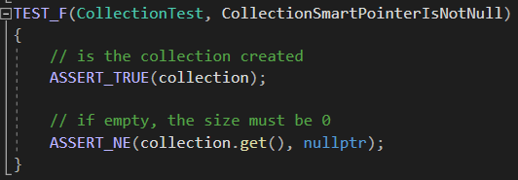
Unit Testing
Collection Smart Pointer Is Not Null

Slide 9
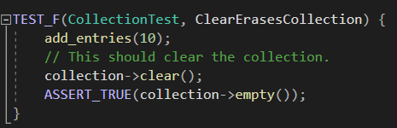
Unit Testing
Clear Erases Collection

Slide 10
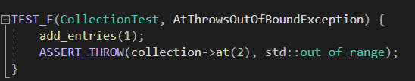
Unit Testing
At Throws Out Of Bounds Exception

Slide 11
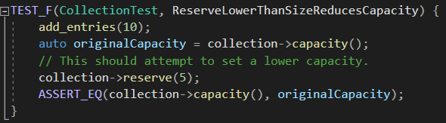
Unit Testing
Reserve Lower Than Size Reduces Capacity

Slide 12

AUTOMATION SUMMARY

Slide 13
TOOLS
The DevSecOps pipeline is a security focused strategy integrated within the software development lifecycle, considering security measures from the design stage to the production stage.
Some external tools that could be utilized for DevSecOps are SAST for secure coding, DAST and SCA for testing, SIEM for monitoring and incident response platforms for automating security checks and responses.

Slide 14
RISKS AND BENEFITS
Potential problems: security risks, unexpected application behavior, and potentially unsecure data.
Potential solutions: Integrate defense in depth to secure the application, allocate resources to protect against potential threats, prioritizing ones that could be substantial security risks, are likely to occur, and costly to mitigate, and follow the security policies outlined on the document.
Potential risks of waiting: security incidents could occur, and if the application is not very secure, these incidents could cause loss of data confidentiality, and or application functionality.
Potential benefits of acting now: protecting application availability, and data integrity and confidentiality.

Slide 15
RECOMMENDATIONS
The policy document could be updated regularly, to keep up with the latest potential security threats.
Staff members could regularly take security training to potentially better implement the standards and policies outlined in the document.

Slide 16
CONCLUSIONS
All standards outlined in the security policy document could potentially be followed for application and data security. These standards could be prioritized based on the potential severity of the security risk, the likelihood of occurrence, cost of mitigation.

Slide 17
REFERENCES
SEI CERT C++ Coding Standard - SEI CERT C++ Coding Standard -
Confluence. (n.d.). Wiki.sei.cmu.edu.
https://wiki.sei.cmu.edu/confluence/pages/viewpage.action?pageId=88046682
Roe, S. (2021, May 10). SAST, DAST, SCA: What’s Best For AppSec Testing? DevOps.com.
https://devops.com/sast-dast-sca-whats-best-for-appsec-testing/
What Is SIEM? | Microsoft Security. (n.d.). Www.microsoft.com.
https://www.microsoft.com/en-my/security/business/security-101/what-is-siem

